Slide 1
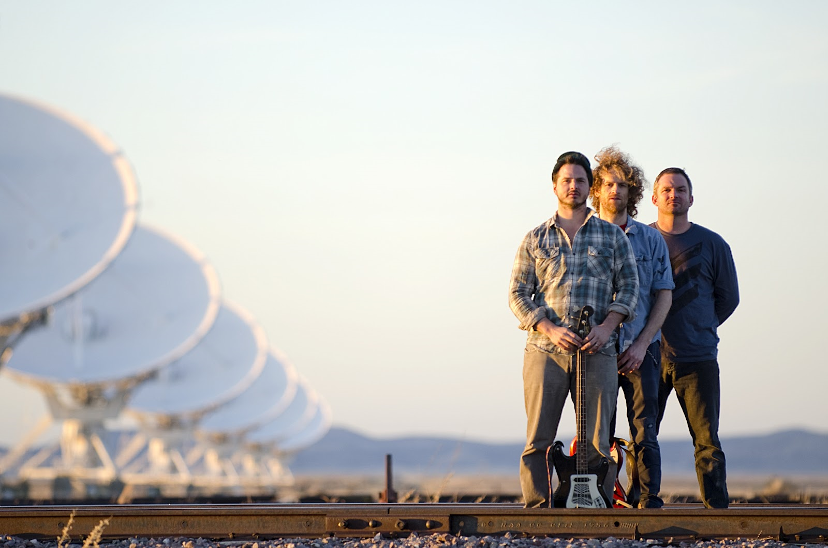

Dispatch
By Amber Ramundo

Slide 2
Dispatch : A send off to a destination or for a purpose
Three-piece independent rock band established in 1996
Each member sings lead vocals and trade instruments on stage
Band capitalizes on giving back to world-wide causes
Three sold out shows at Madison Square Garden in 2007 raised awareness and provide humanitarian relief for the people of Zimbabwe
Amplifying Education campaign aimed to show how small actions can make a big difference in the lives of children throughout the world

Slide 3
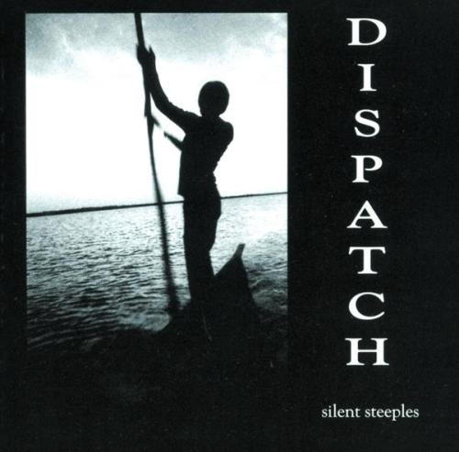
Steeples
Past the Falls
Water Stop
Hey, Hey
Flying Horses
Questioned Apocalypse
Seasons Movement III
Mayday
Born Normal
Bridges
Walk With You
Elias
Other Side
Craze

Slide 4
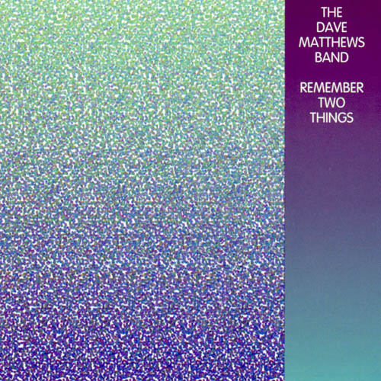
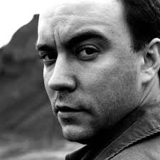

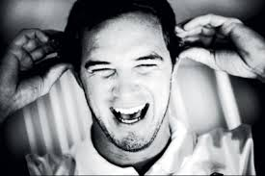

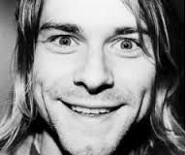
Lead Vocals
Band
Fist Album
Hit Song
Dave Matthews
Ants Marching
Slightly Stoopid
Closer to the Sun
Sublime
Santeria

Slide 5
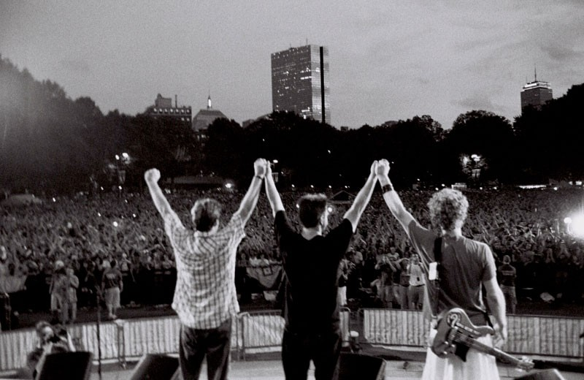
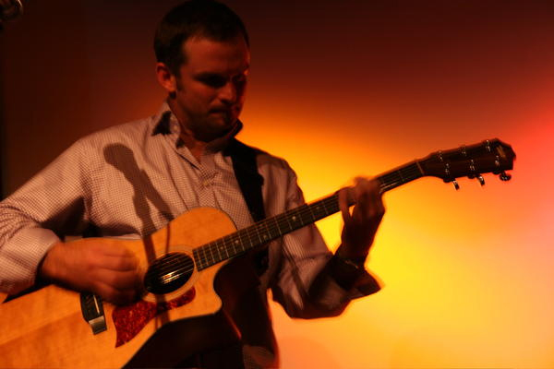
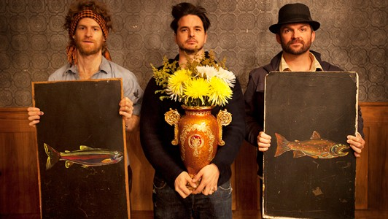
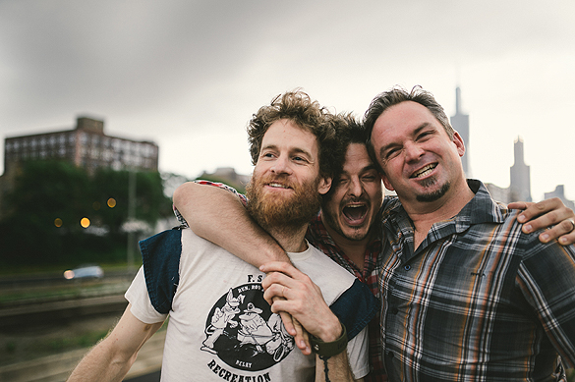
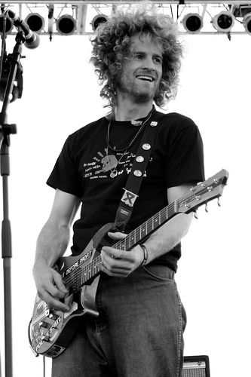
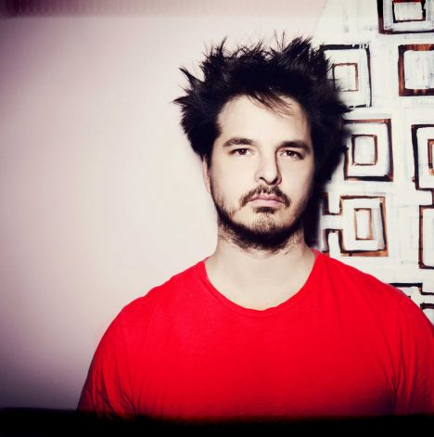
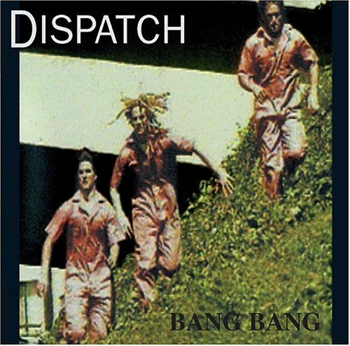
Dispatch

